Slide 1
Text Analysis and Machine Learning Workshop
Jason Kiley
Oklahoma State University
Part 1: Overview and Tools

Slide 2
github.com/jtkiley/

Slide 3
Related
AOM Big Data workshop with Tim Hannigan, Hovig Tchalian, and Laura Nelson (on Github).
My AOM Content Analysis PDW presentation (on the UGA Content Analysis website).
My SMS workshop on workflows for big data (on Github).

Slide 4
Agenda
Tools: Anaconda, Python, packages and environments
Basics: Python syntax and conventions, Jupyter Notebooks
Data: gathering, preparation, and management
Content analysis: features, sentiment, classification, and validation

Slide 5
Schedule
Overview and Tools | 9:00-10:00
Python Basics | 10:15-11:15
Data Handling | 12:30-13:45
Text Analysis | 14:00-15:00
Machine Learning | 15:15-16:30

Slide 6
Overview

Slide 7
Overview
What you really need to know about Python.
Resources for learning.
Reproducibility and Python workflows.

Slide 8
What do I really need to know about Python?

Slide 9
Why Python?
Approachability: well-designed modern programming language that handles a lot for you.
Features: many things have been built already, and you simply “glue” them together.
Learning resources: wide popularity in academia and practice means that there are extensive resources.
Scalability: from your computer, to the cloud, to a computing cluster, you can use largely the same tools.

Slide 10
Python Fluency
Software Development
Good-enough Programming
Data preparation
Basics

Slide 11
Basics
Skills | Software: Anaconda, Python interpreter, Jupyter Notebooks Variable types: strings, ints, floats Objects and methods: lists, dictionaries Packages: importing and installing Documentation: official and community
Time | 2-4 hours
Necessity | Largely unavoidable

Slide 12
Data Preparation
Skills | Software: pandas Reading data formats (built-in) Slicing, views, df.loc[ ] Operations on columns and rows Reshaping Merging and querying
Time | 1-2 days and ongoing
Necessity | Needed and high ROI

Slide 13
Good-enough Programming
Skills | Loops Writing functions Reading and writing files (the hard way) Throwing and handling exceptions Using additional packages End point: working, reusable script
Time | 1 week and ongoing; divisible
Necessity | Helpful and good ROI

Slide 14
Software Development
Skills | Classes and inheritance Package development Version control Unit testing and continuous integration Cross-version support Open source contributions
Time | A lot
Necessity | Not at all; good for the field

Slide 15
What resources are available for learning?

Slide 16
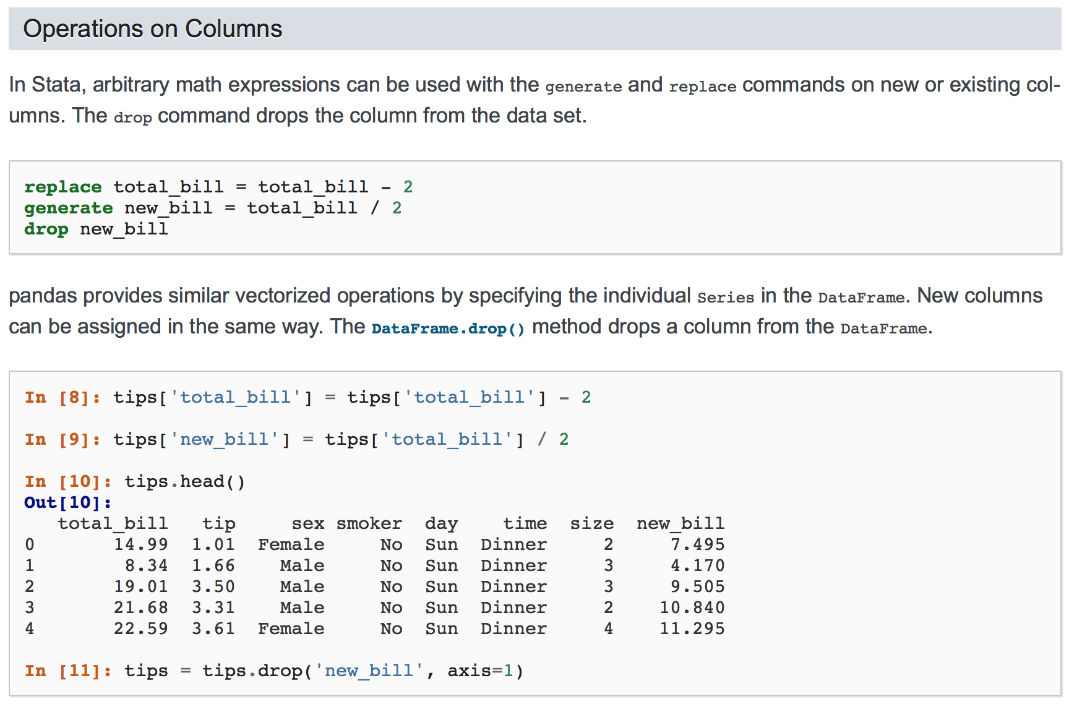
pandas documentation
Comparison with Stata

Slide 17
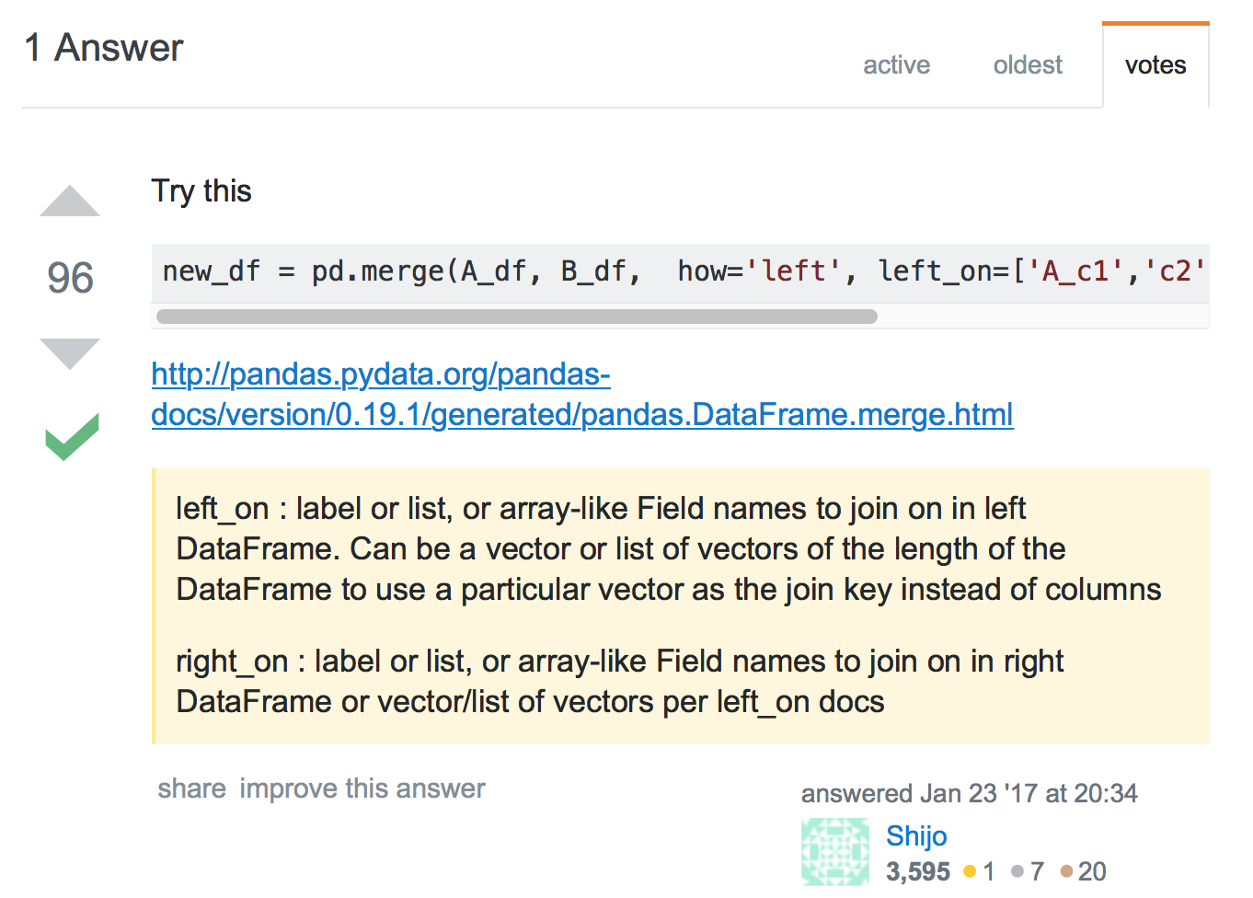
Stack Overflow
Search for what you are trying to do, merging on multiple columns with different names, in this case.

Slide 18
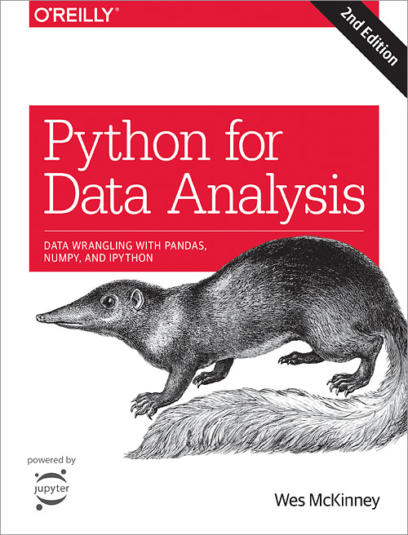
Python for Data Analysis
Wes McKinney
creator of pandas and other open source projects

Slide 19
Other resources
edX: many courses that use or teach Python that are relevant for data work (free).
Data Camp: video courses from basic data preparation up to machine learning ($29/month)

Slide 20
What about R?
R is great overall, especially compared to a lot of commercial stats software.
Compared to Python, it is less general purpose, so some useful packages may not have analogues.
The syntax (from S in the 1970s) is sometimes quite arcane.

Slide 21
How can Python help with reproducibility?

Slide 22
Reproducibility
Overall: Can I or someone else reproduce my data and results?
Documentation: can I show my work?
Efficiency: can I easily make changes in the middle of my data pipeline?
Authoritativeness: can I demonstrate that my documentation accurately reflects my work?

Slide 23
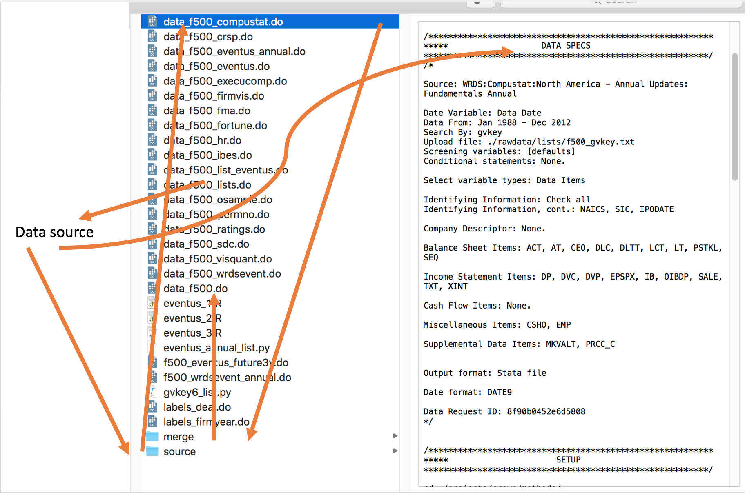

Slide 24
data_0
prep_0
merge_0
data_1
prep_1
merge_1
prep_all
final
data_n
prep_n
merge_n
Documentation

Slide 25
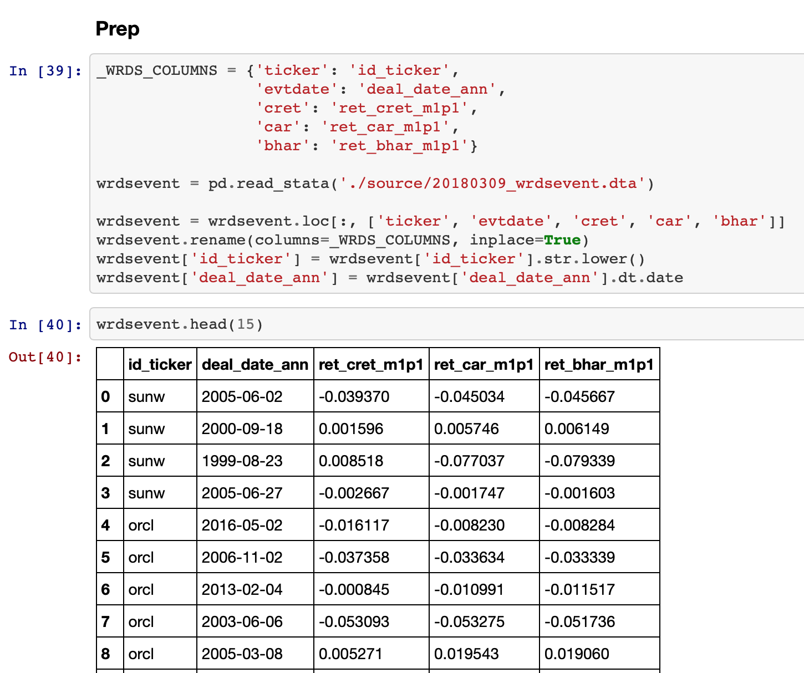
Code that runs
Make all changes to data in code that runs cleanly on the original data.
Running code makes changes very efficient.
Rerunning it proves that it is authoritative.

Slide 26
Anaconda

Slide 27
Anaconda
What is Anaconda?
Packages and package management.
Environments: consistency, portability, and reproducibility.
Warning: bad photo analogies ahead.

Slide 28
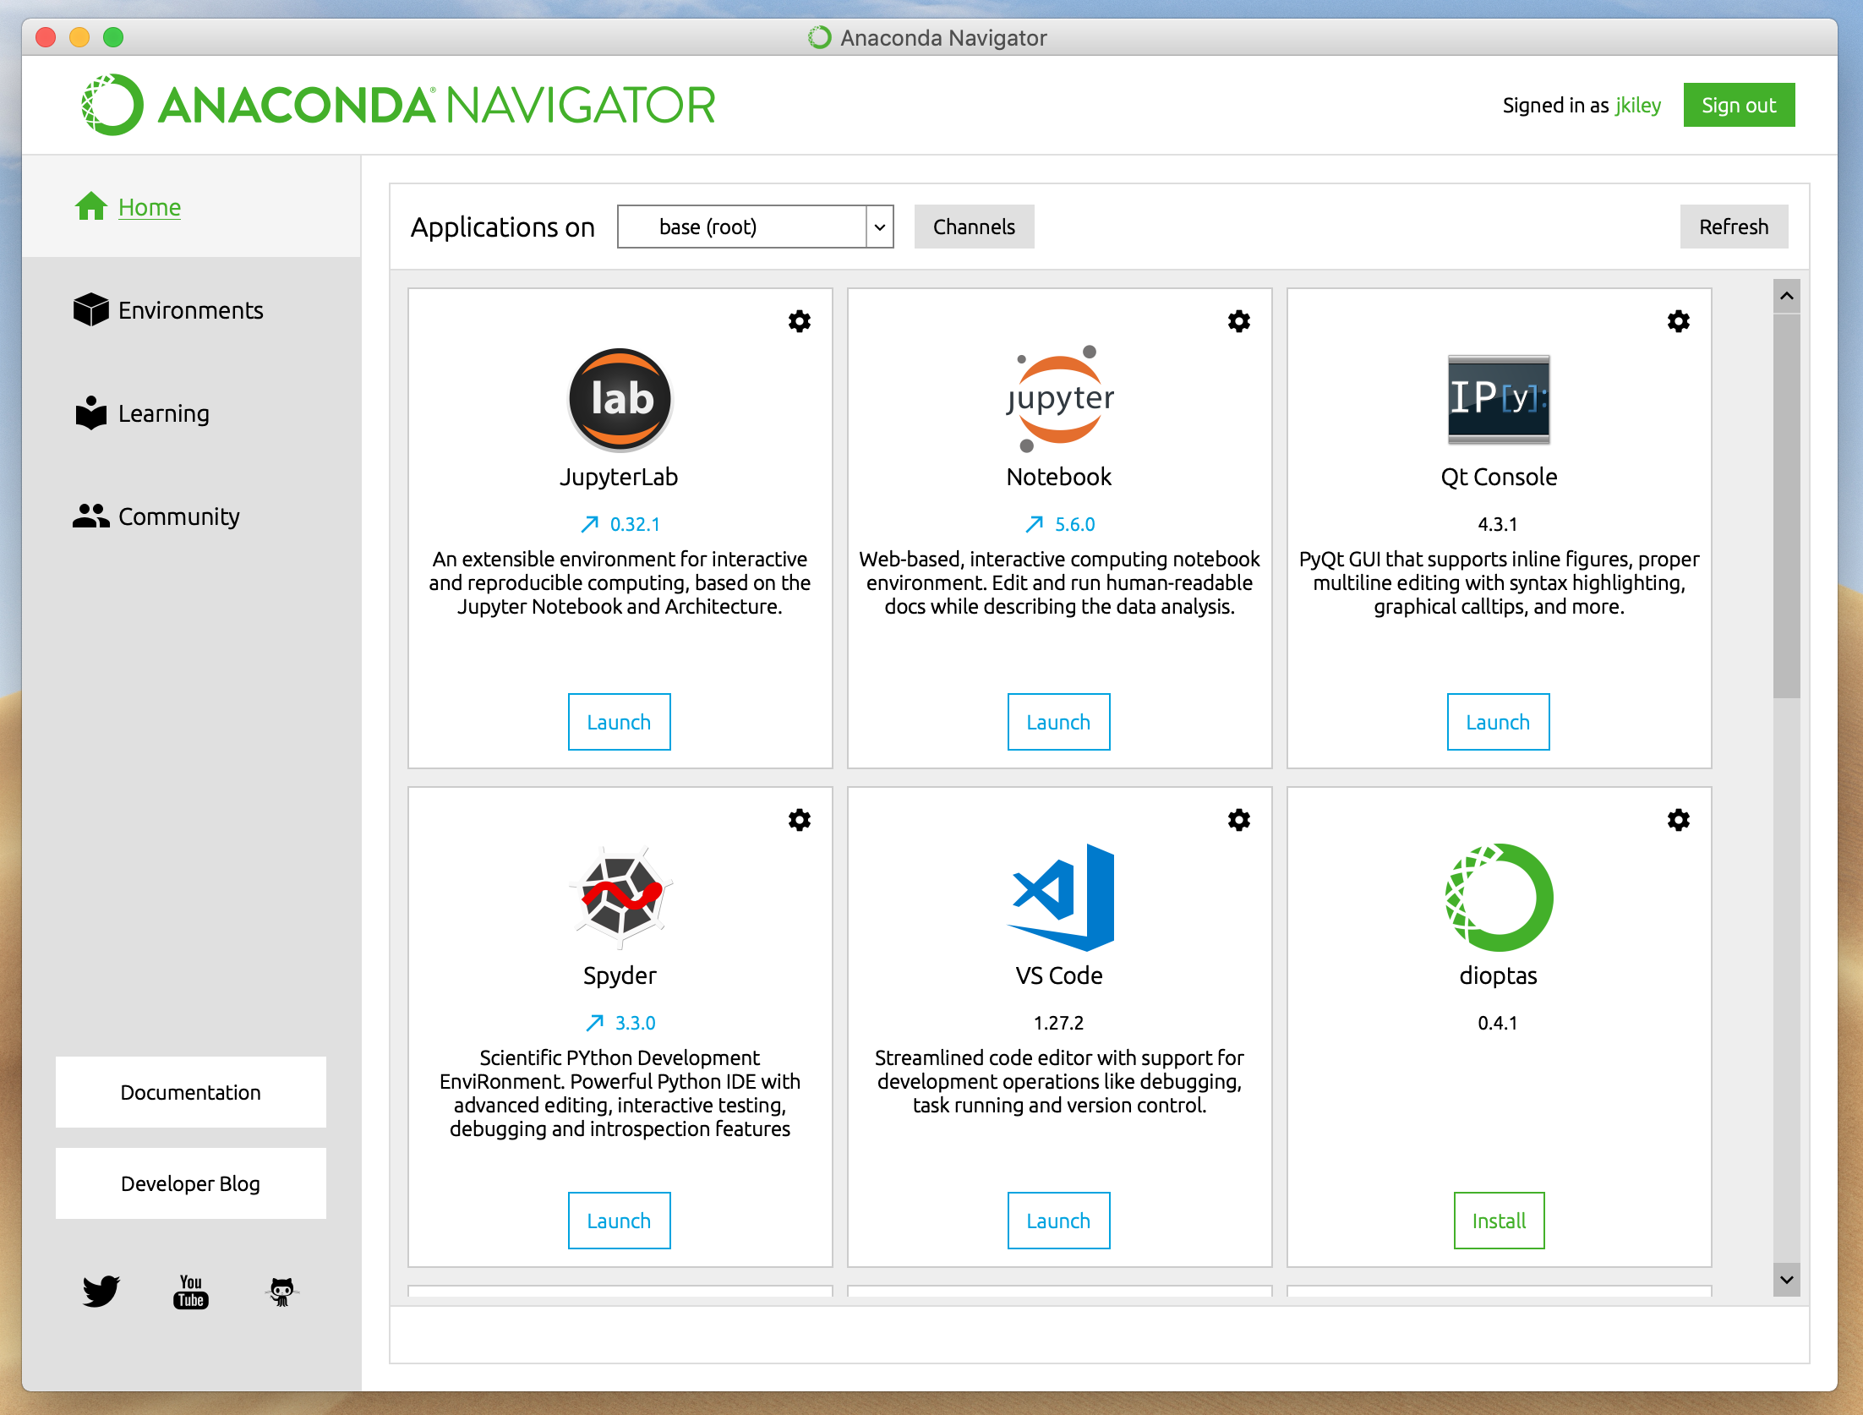

Slide 29
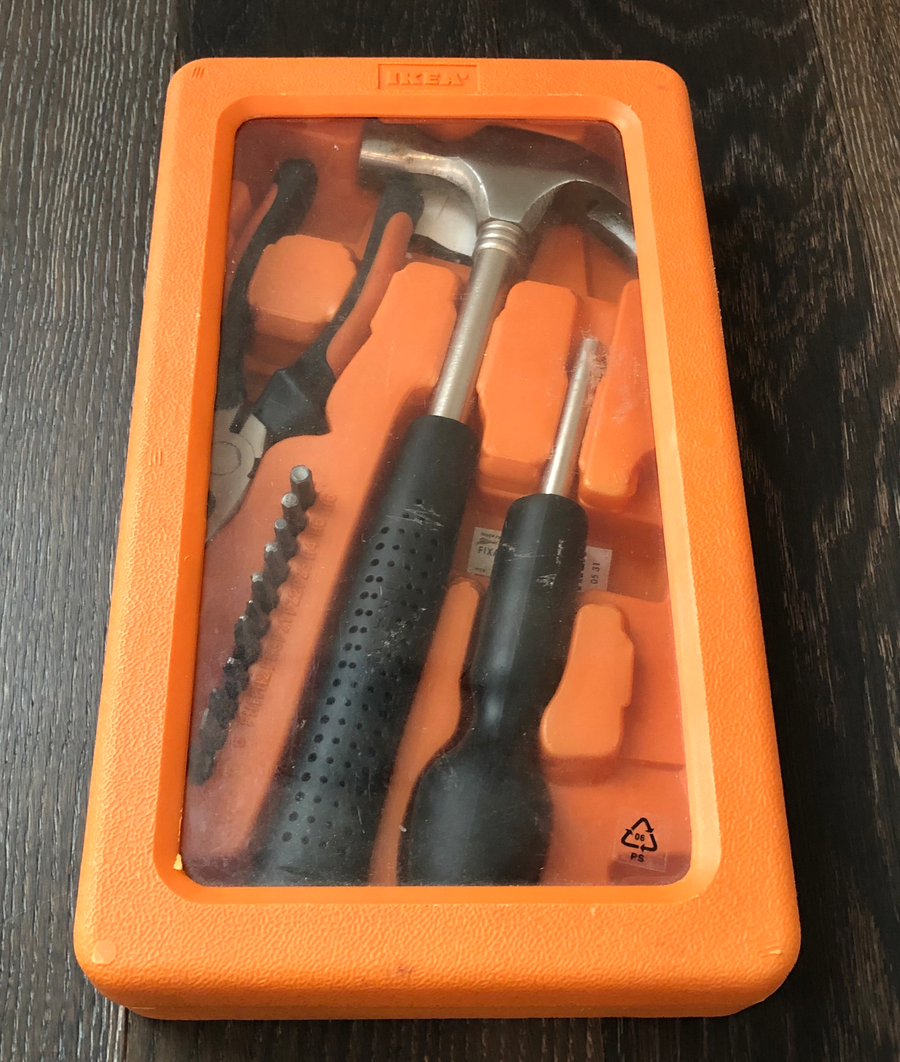
Anaconda
Anaconda is a Python and R distribution aimed at data science users.
A distribution aims to assemble a full set of tools for you, often built by numerous groups of people.
Other examples: Linux, LaTeX

Slide 30
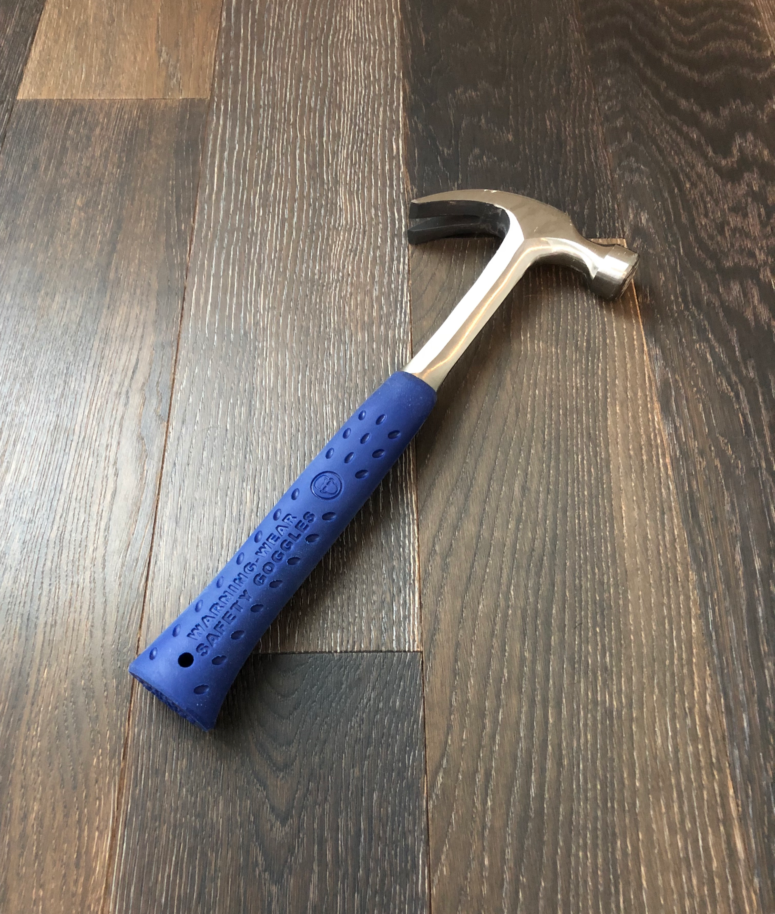
Packages
Packages are usually individual tools.
They vary in complexity and scope.
They also depend on other packages.

Slide 31
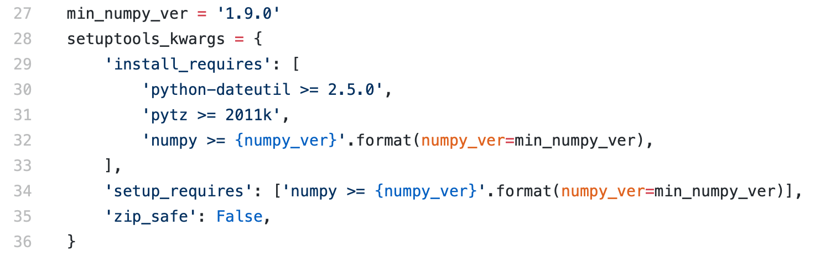
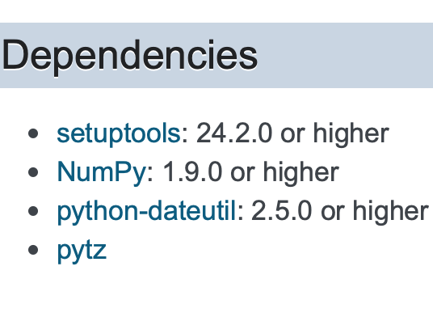
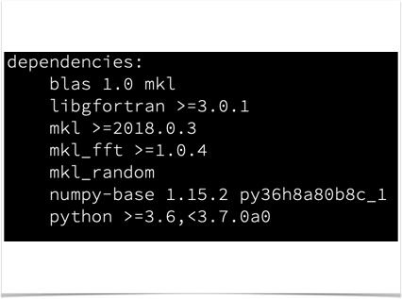

Slide 32
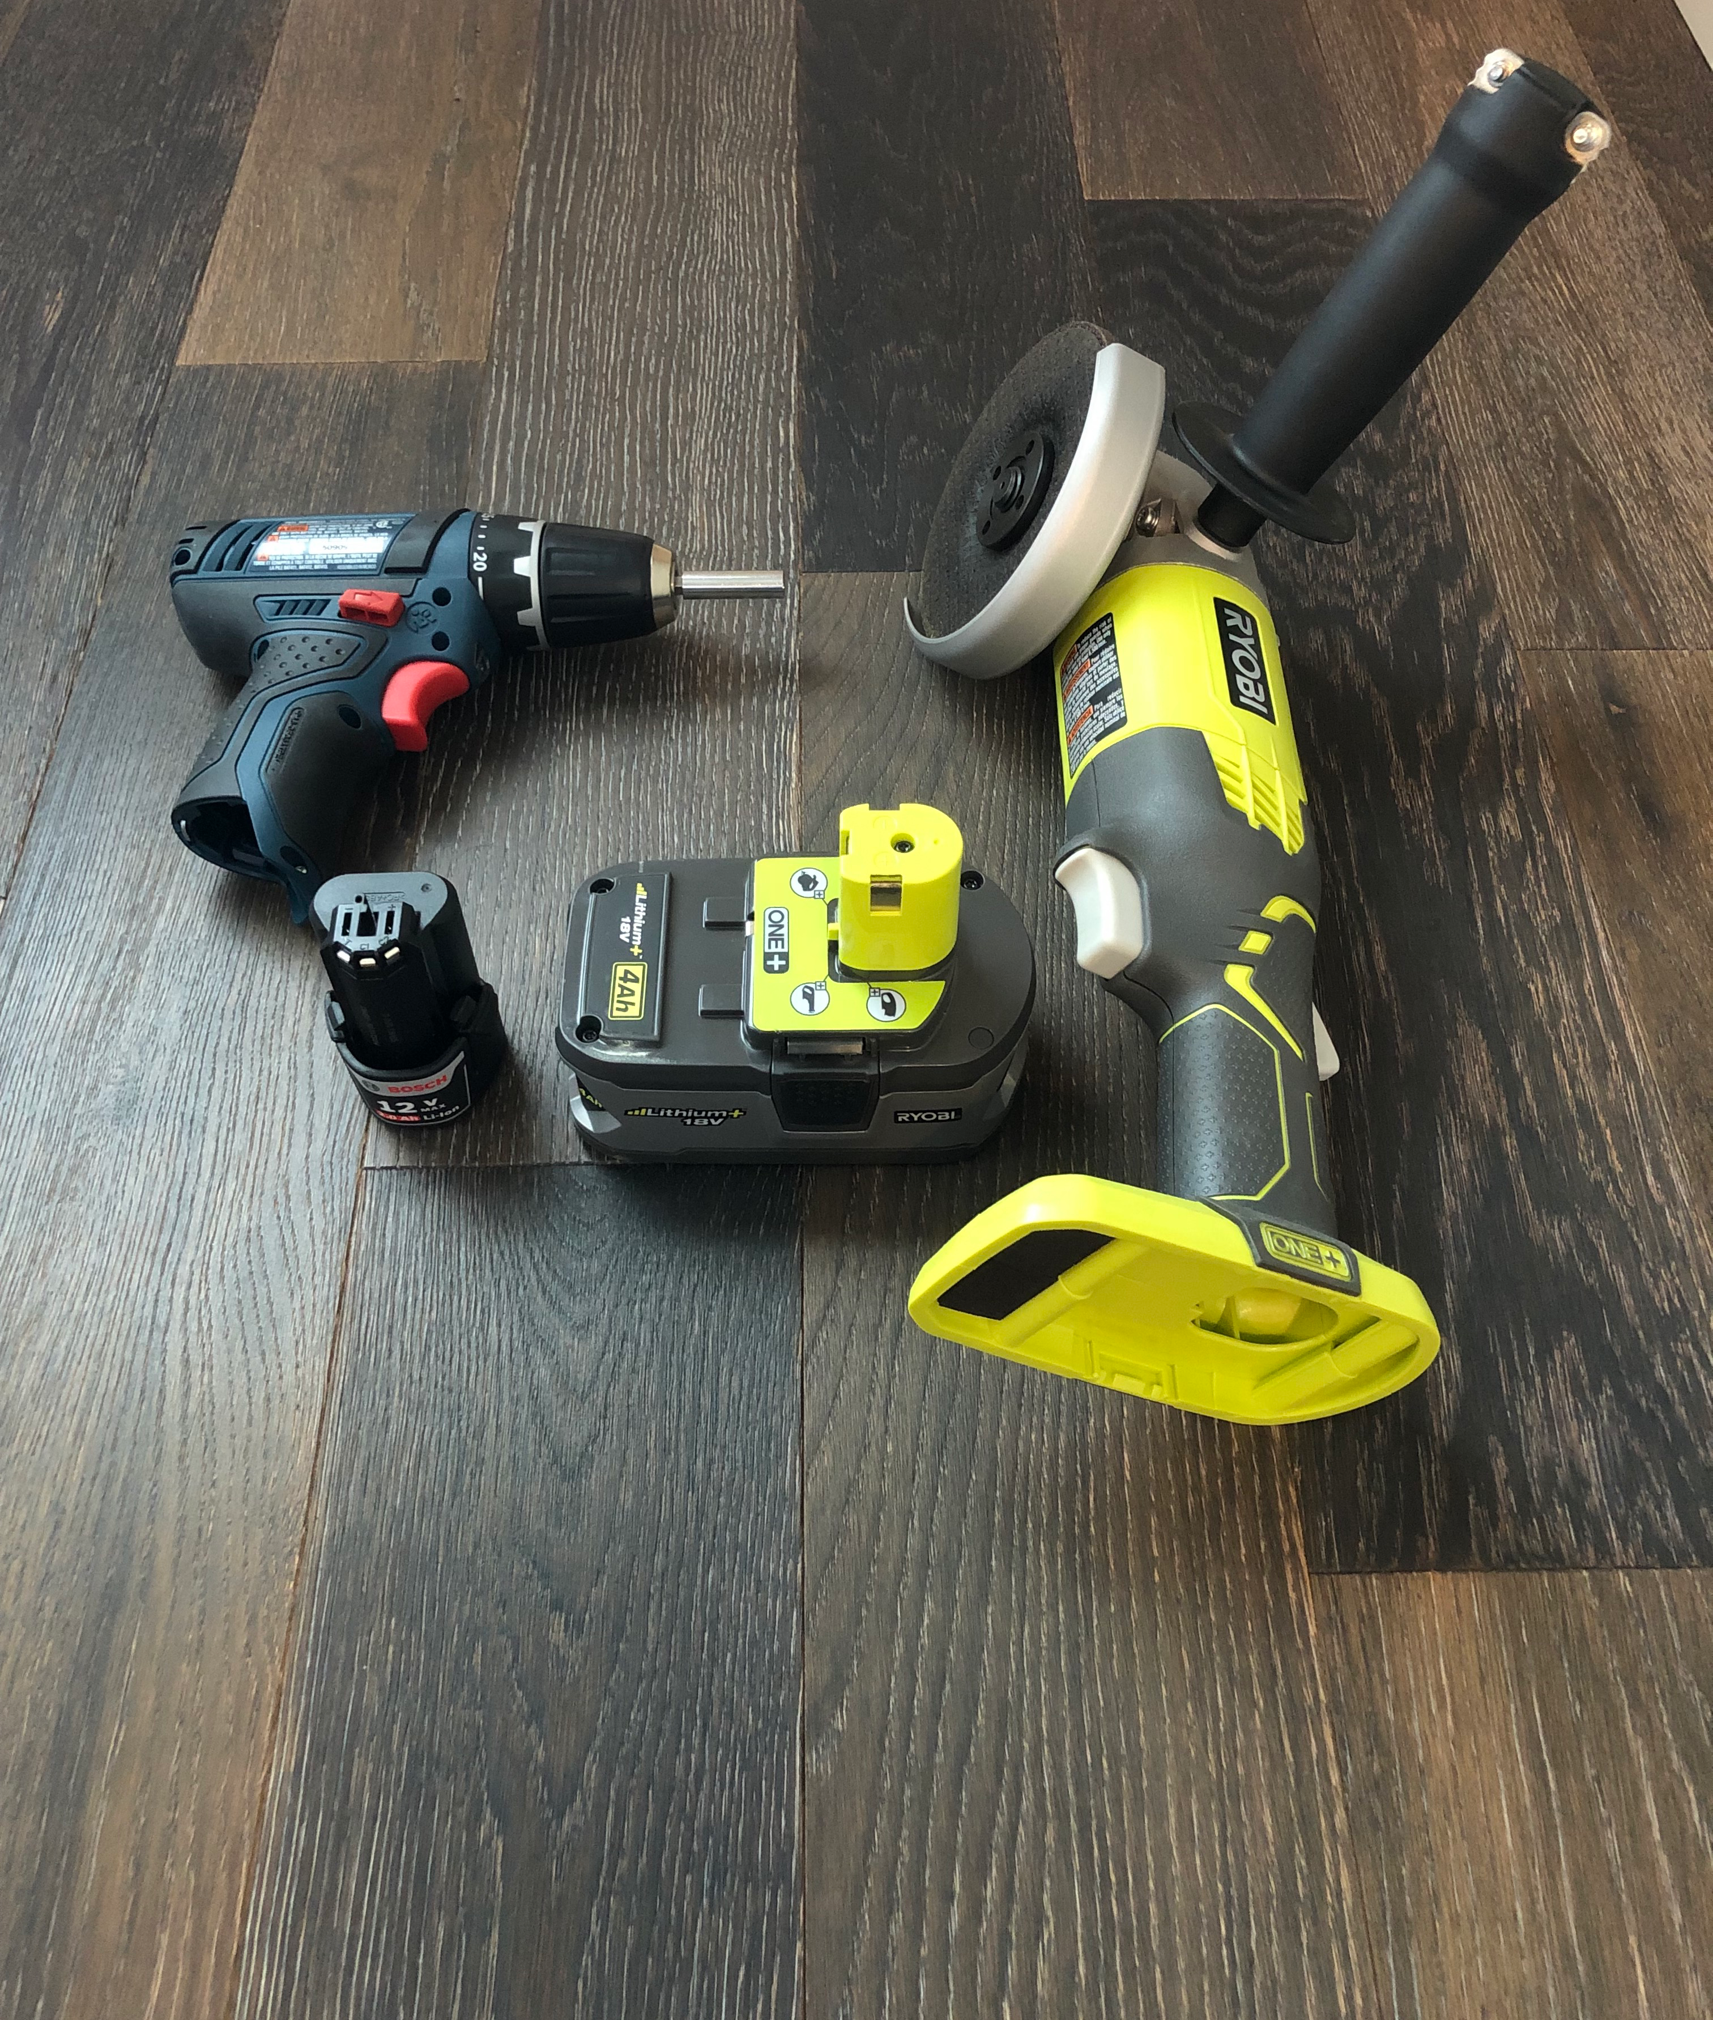
Package managers
Package managers do the work of handling dependencies for us.
With a few large packages, the total dependencies can be over 100.
This workshop: 8 primary packages installed 128 total packages.

Slide 33
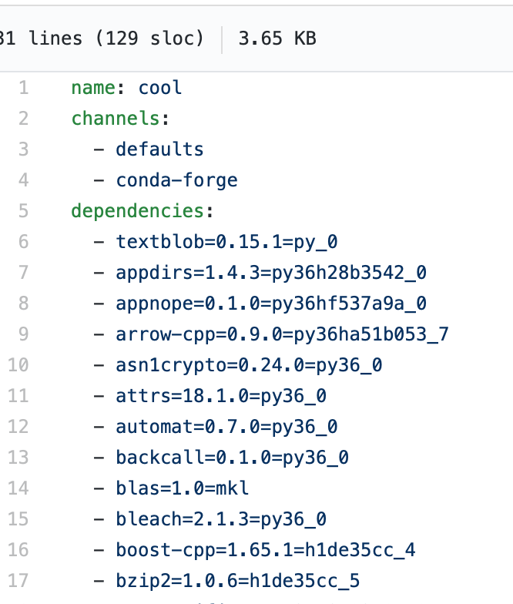
Environments
Fix the software versions that you use, so updates do not affect your study.
Each project should have its own environment.
Conda environments make this fairly easy.
Update as needed, but check your results.

Slide 34
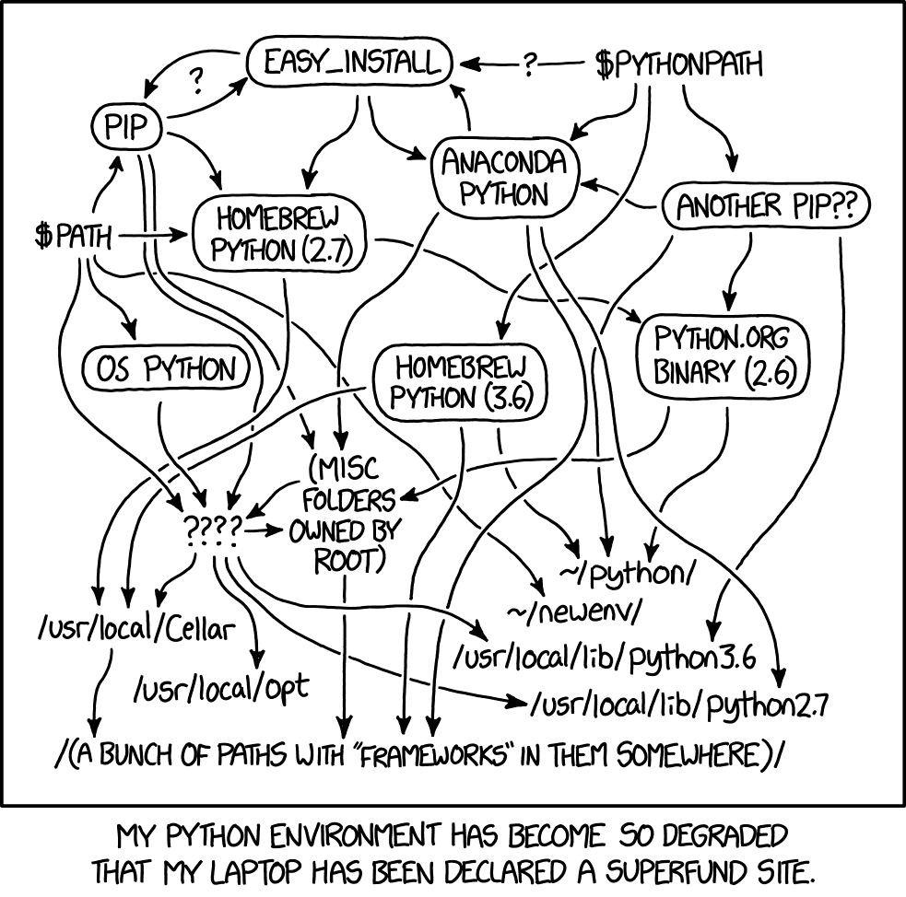
Notes:
Permanent link to this comic: https://xkcd.com/1987/

Slide 35
Hands-on
Create an environment.
Importing packages.
Inspecting packages (and other objects).
Alternative interfaces with Python.

Slide 36
Hands-on

Slide 37
Summary
Using Python for data analysis is not exactly programming, and you already have much of the knowledge you need.
Capturing all of our work in code that runs is a best practice that promotes reproducibility, and that helps us most of all.
Anaconda handles installation and coordination for packages, and it lets us use environments that let each project have its own software set.

Slide 38
Questions

Slide 39
Break until 10:15

